Slide 1
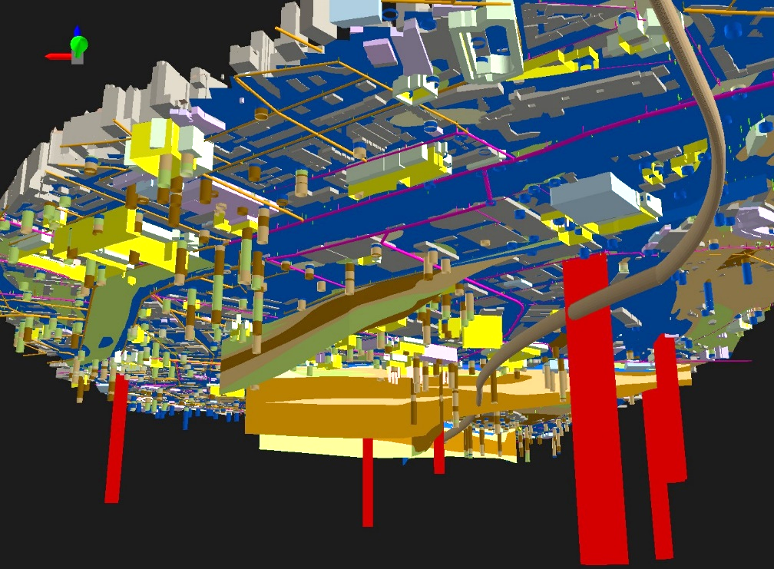
Standardization and use of ‘geotechnical’ data in Switzerland -
A first approach and problems encountered
Stefan Volken
Geotechnical Data Standardization Workshop Paris, 22 - 24 January 2019

Slide 2
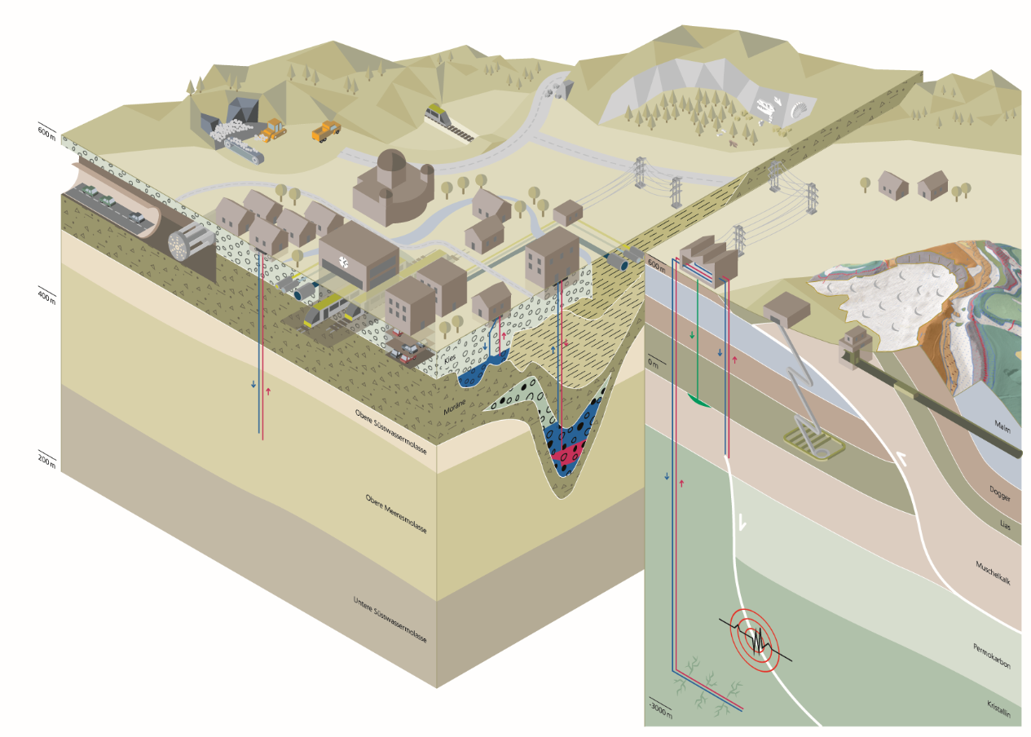
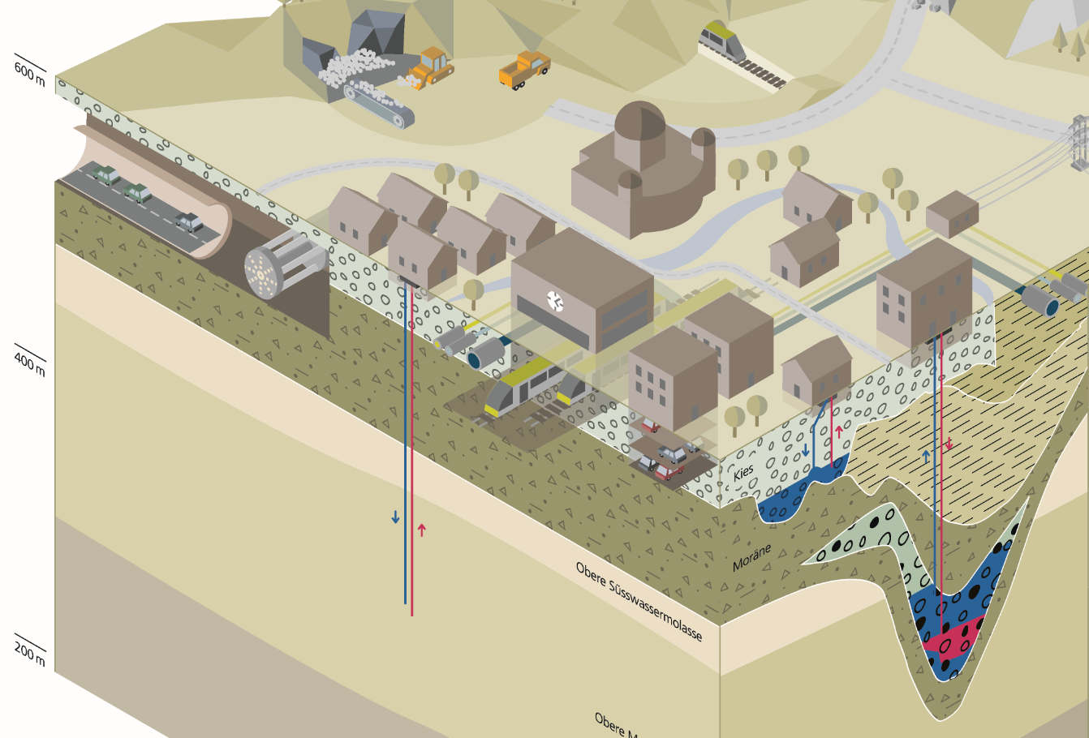
SGS Tasks
Managing Geological information between the Earth’s surface and 5’000 meters depth → Dealing with a wide scale range (local to national)
Geological (incl. hydrogeological and geotechnical) data are required for various uses and hazard management above and below ground. → The challenge of standardizing geological data → Need of data and tools for planning of competing underground uses

Slide 3
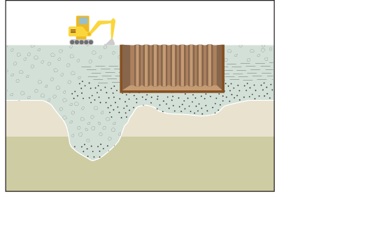
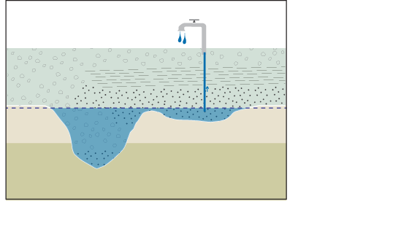
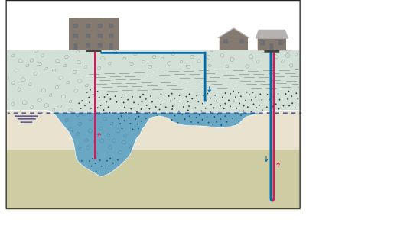
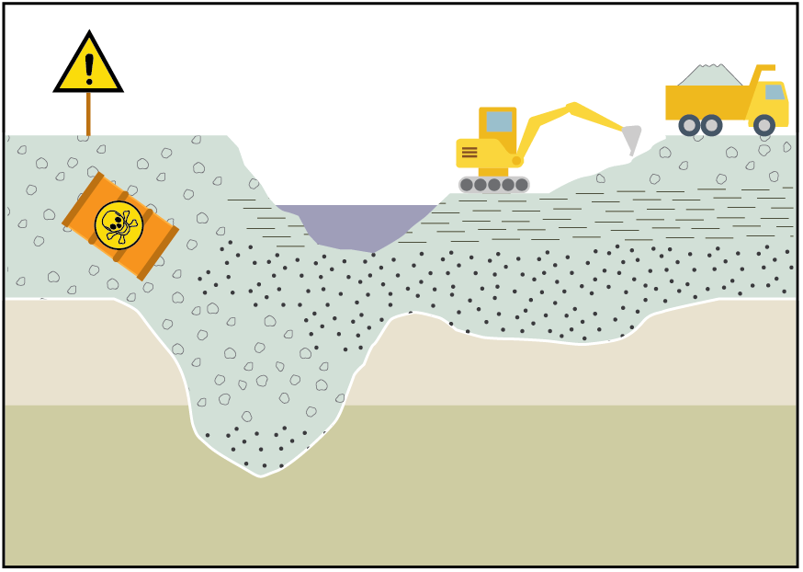
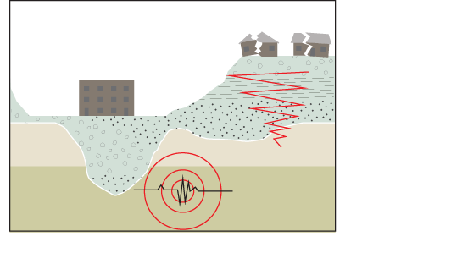
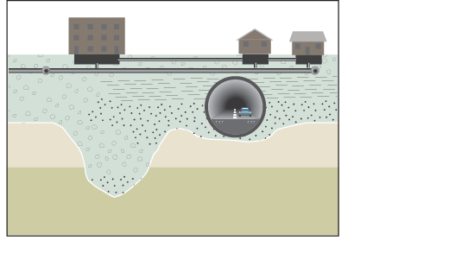
Uses and hazard prevention in the (shallow) subsurface
Geotechnics
Hydrogeology
Geothermics
Materials management: Mineral raw materials, contaminated sites, landfills
, …
Earthquake prevention
Building / City Information Modeling (BIM / CIM)
Notes:
unterschiedliche Anforderungen an Lockergesteinsuntergrund
unterschiedliche Daten resp. Klassifikationen zum Lockergesteinsuntergrund werden benötigt
ohne gut strukturierte Lockergesteinsdaten ist eine Koordination zwischen den Nutzungen fast nicht möglich → Nutzungskonflikte
damit geologische oder parametrische 3D-Modelle und daraus abgeleitete Produkte erstellt werden können, braucht es einheitlich erfasste und klassifizierte quartäre Lockergesteinsdaten

Slide 4
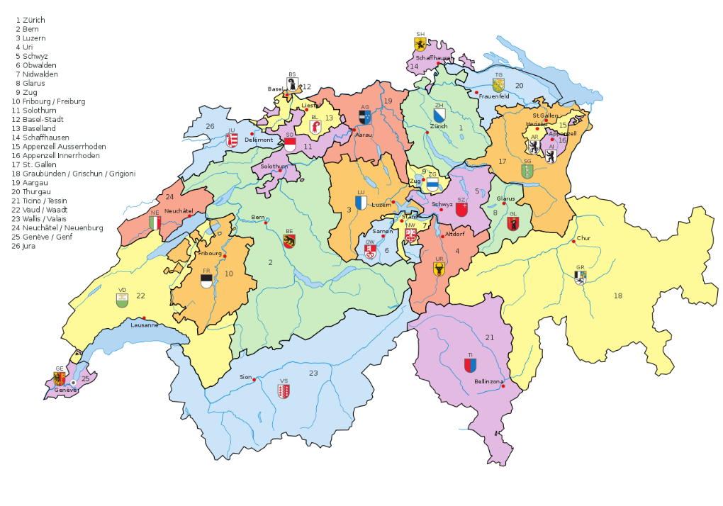
Issues with available data
The available data is very heterogeneous in structure and format.
The cantons have the sovereignty over the borehole data, thus each of the 26 cantons can actually specify its own guidelines for how the borehole data has to be delivered.
→ Therefore a comparison and a common use of the borehole data is almost impossible. → Need for national geological data models

Slide 5
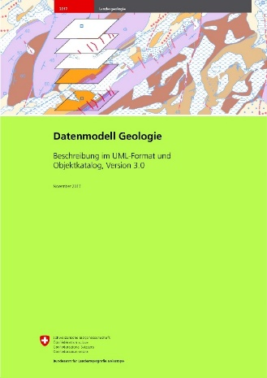
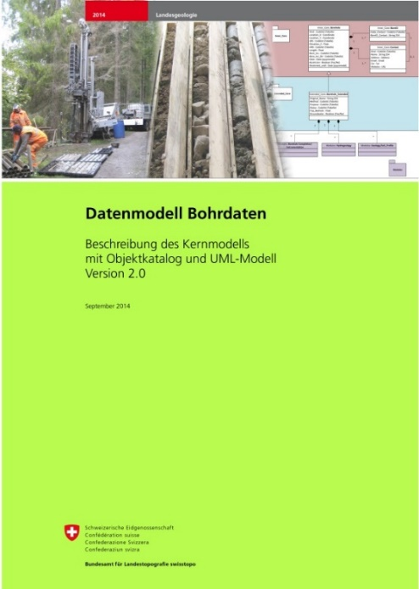
Existing Data Models

Slide 6
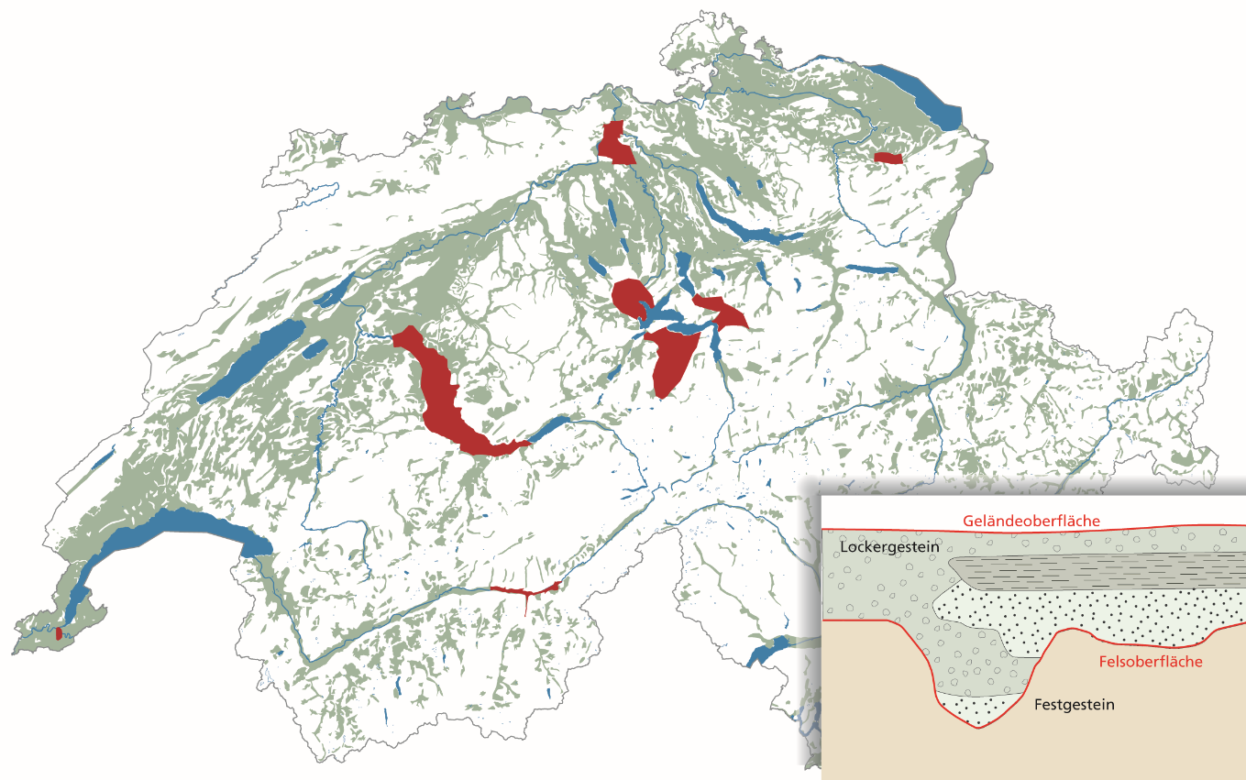
Pilot areas (Project GeoQuat)

Slide 7
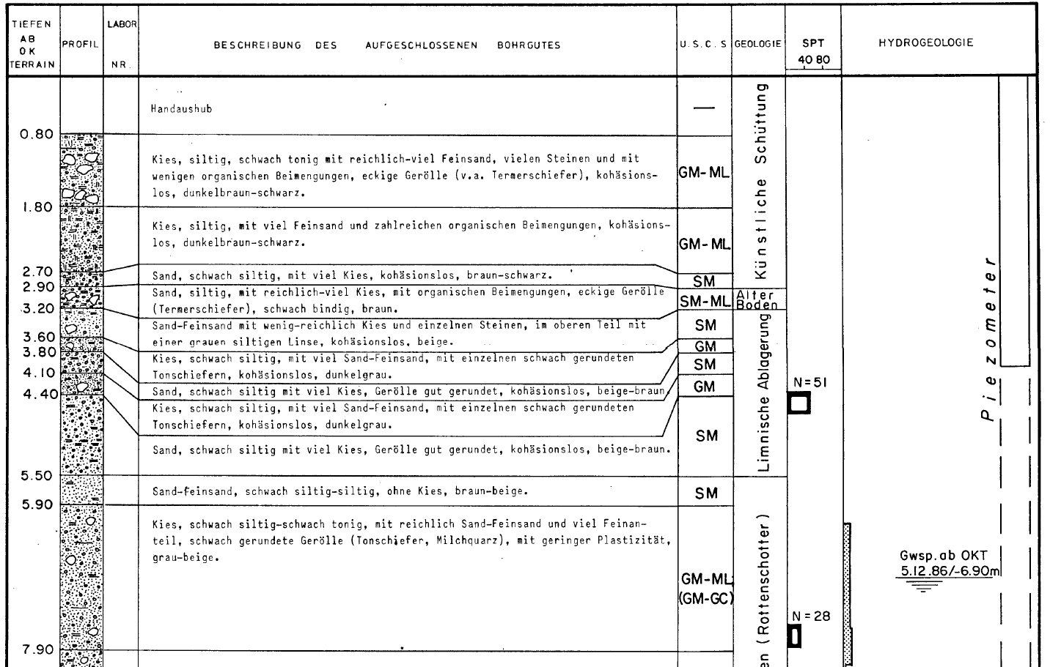
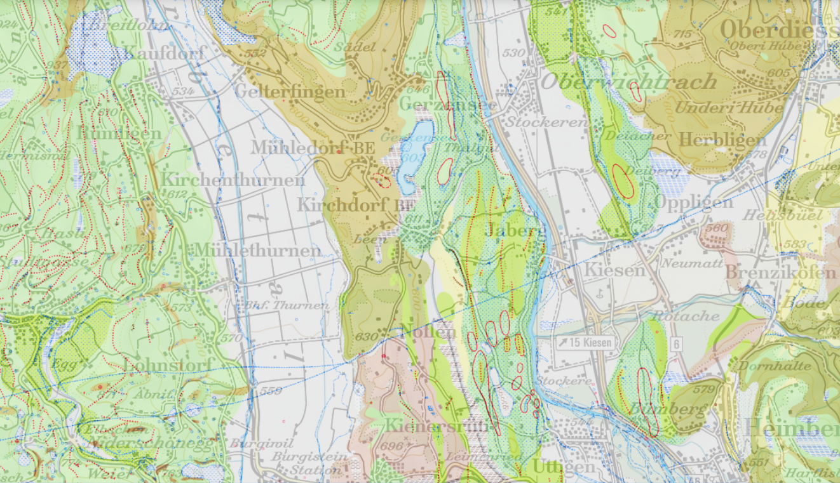
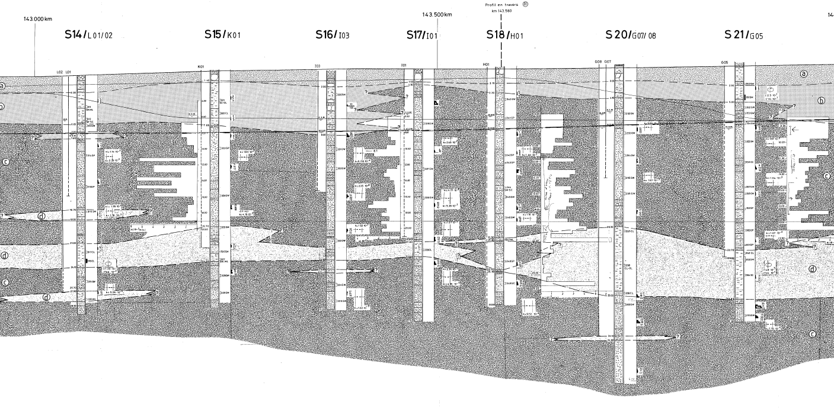
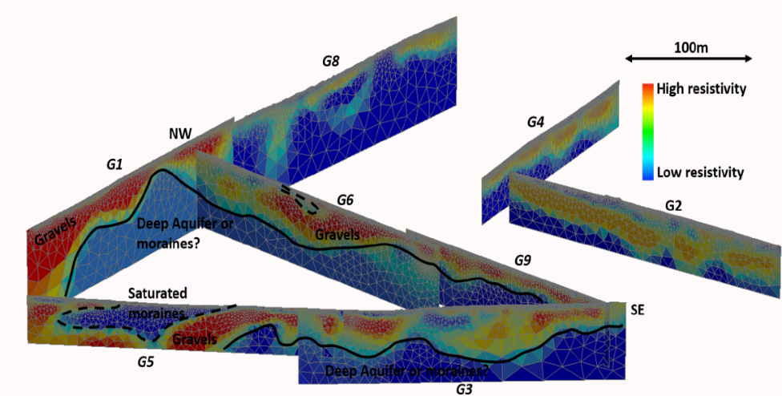
Availability of geological, geotechnical, hydrogeological and geophysical data
Borehole data (including geotechnical and hydrogeological test results
Geological / geotechnical maps
Geophysical measurements (e.g. cross sections)
Geological cross sections

Slide 8
Statistics of the captured borehole data
Pilot area | Boreholes | Drilled meters | Individual layers
Birrfeld | 1'577 | 37'230 | 19'830
Visp | 788 | 17'955 | 11'674
Aaretal | 3'280 | 60'215 | 36'275
Vierwaldstättersee | 741 | 15'423 | 8'120
Genf | 615 | 11'240 | 7'143
St. Gallen | 686 | 7'300 | 2'170
Total | 7'687 | 149'363 | 85'212
→ Good data availability up to a depth of approx. 40 meters

Slide 9
Borehole Data Model
Classification of individual layers (1)
Most of the available drilling data in Switzerland is recorded according to the Swiss Standard (SN 670’005a, SN 670'004-1b)
:
boulders
stones
organic additives
peat
clean
silty
clayey
gravel
with
little (<15%)
abundant (15-30%)
much (31-50%)
sand
and with
1st phase
2nd phase
3rd phase
A code is assigned to each phase
It must be indicated whether the 1st phase code was determined [a] in the laboratory or [b] in the field at the time of drilling, or whether it is [c] a third party interpretation according to the layer description.

Slide 10
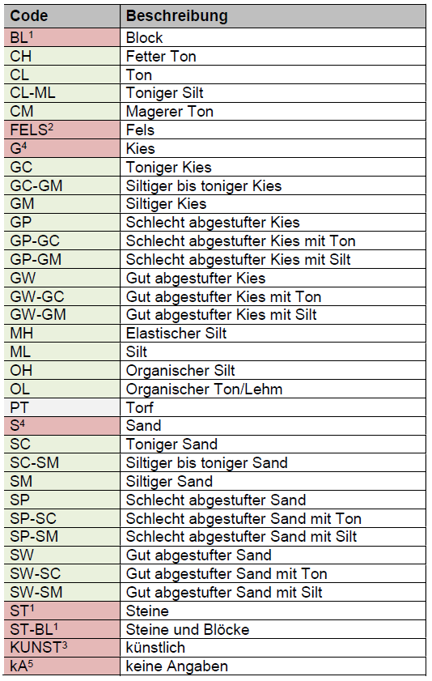
Borehole Data Model
Classification of individual layers (2)
In order to cover the entire grain size spectrum, the list of USCS codes had to be extended to include → extended USCS

Slide 11
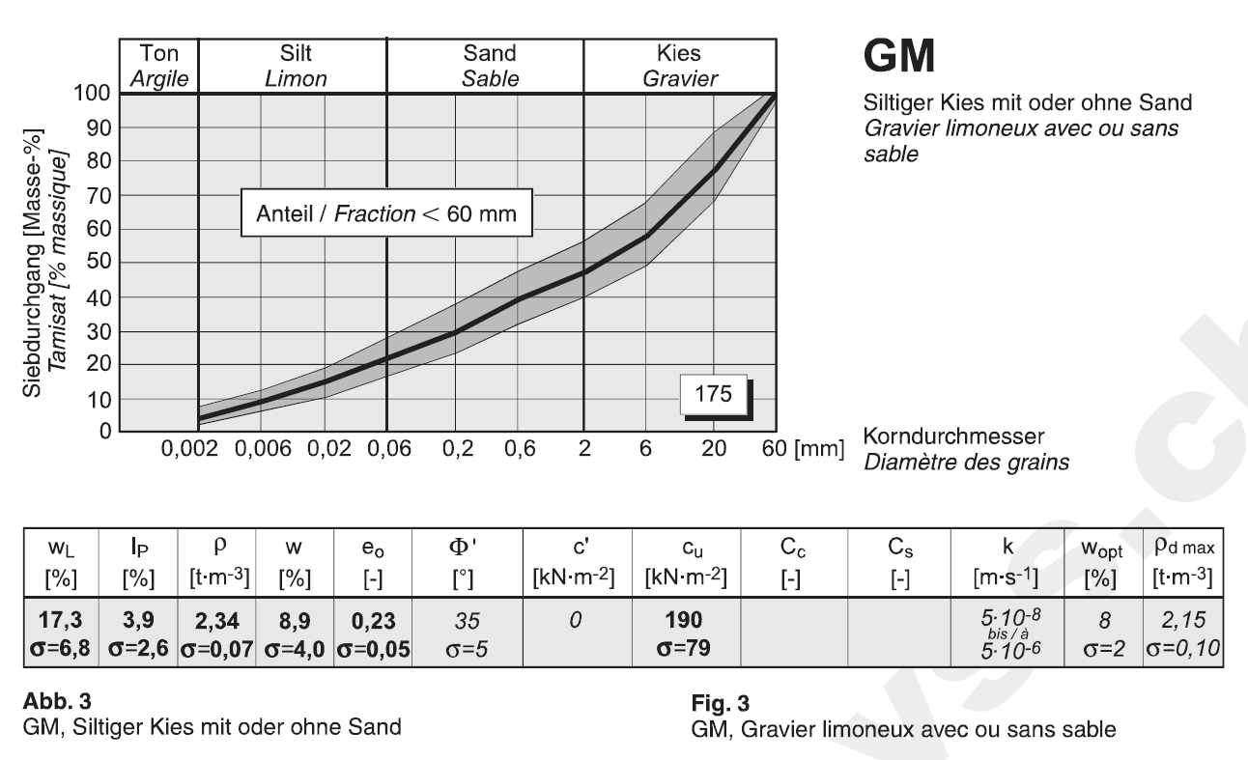
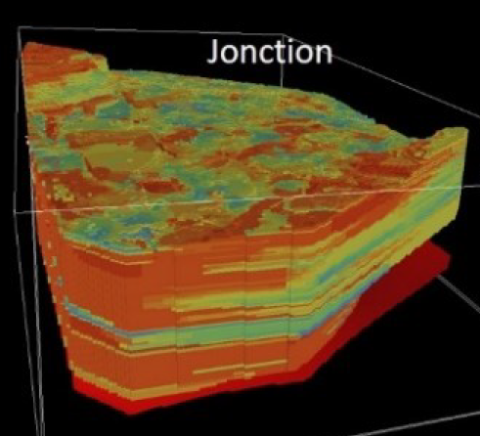
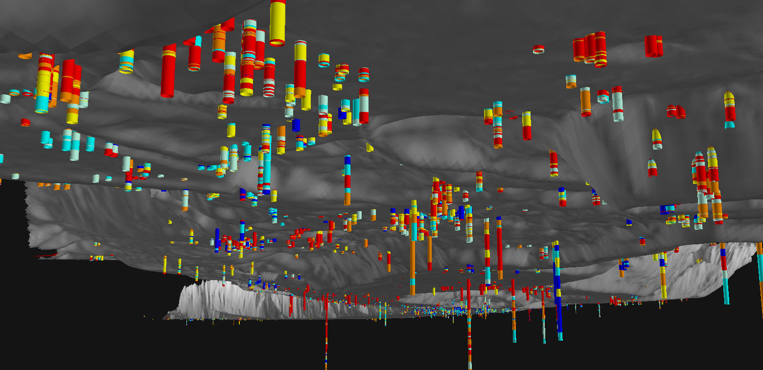
Borehole Data Model
Classification of individual layers (3)
SN 670’010: Typical geotechnical parameter values for each USCS class:

Slide 12
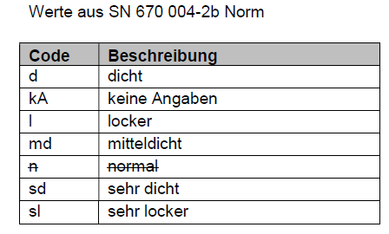
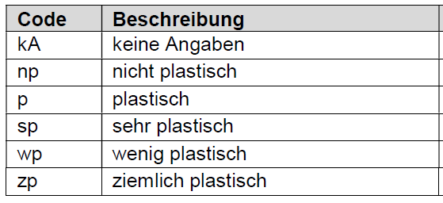
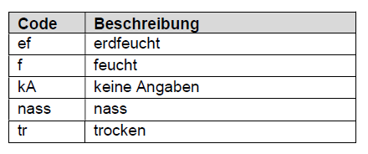
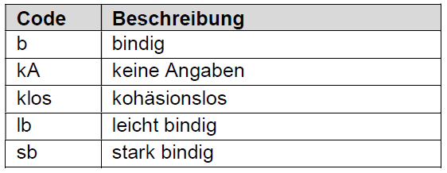
Borehole Data Model
Classification of individual layers (4)
Sediment properties
Density
Plasticity
Humidity
Cohesion

Slide 13
Borehole Data Model
Limited use of Standard Penetration Tests (SPT)
Depth of spt start below surface
No. of spt hits

Slide 14
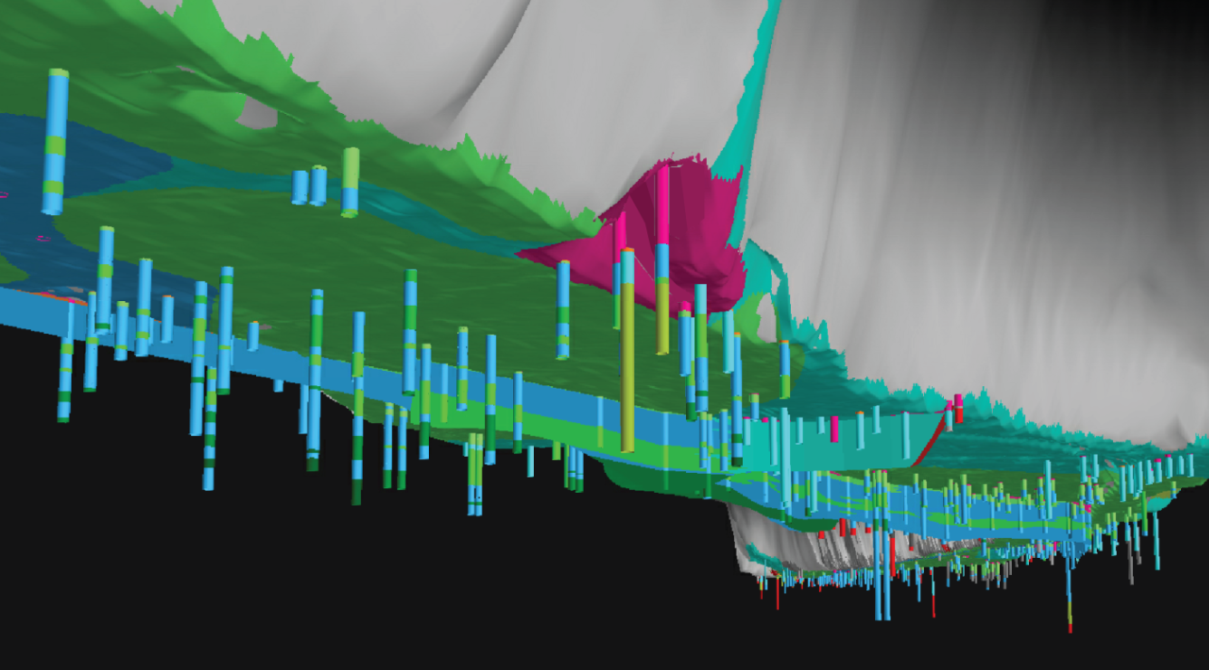
Enabling automation through standardization

Slide 15
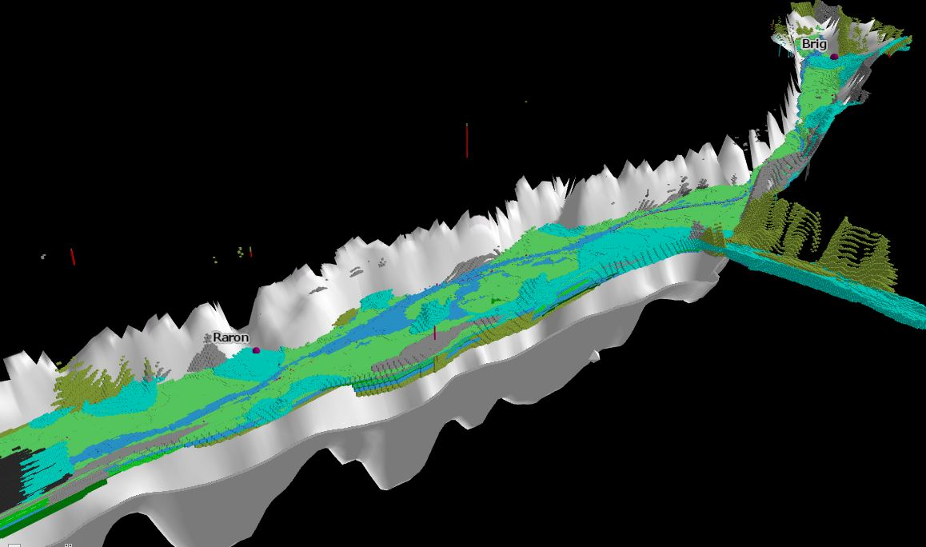
Enabling automation through standardization

Slide 16
Pilot areas
Geneva

Slide 17
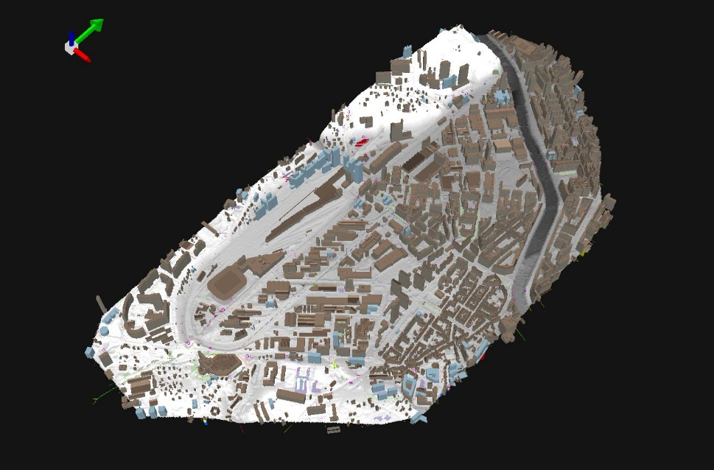
BIM / CIM and Geology
Comparison: underground construction data ←→ underground geological / geotechnical data
3D Buildings

Slide 18
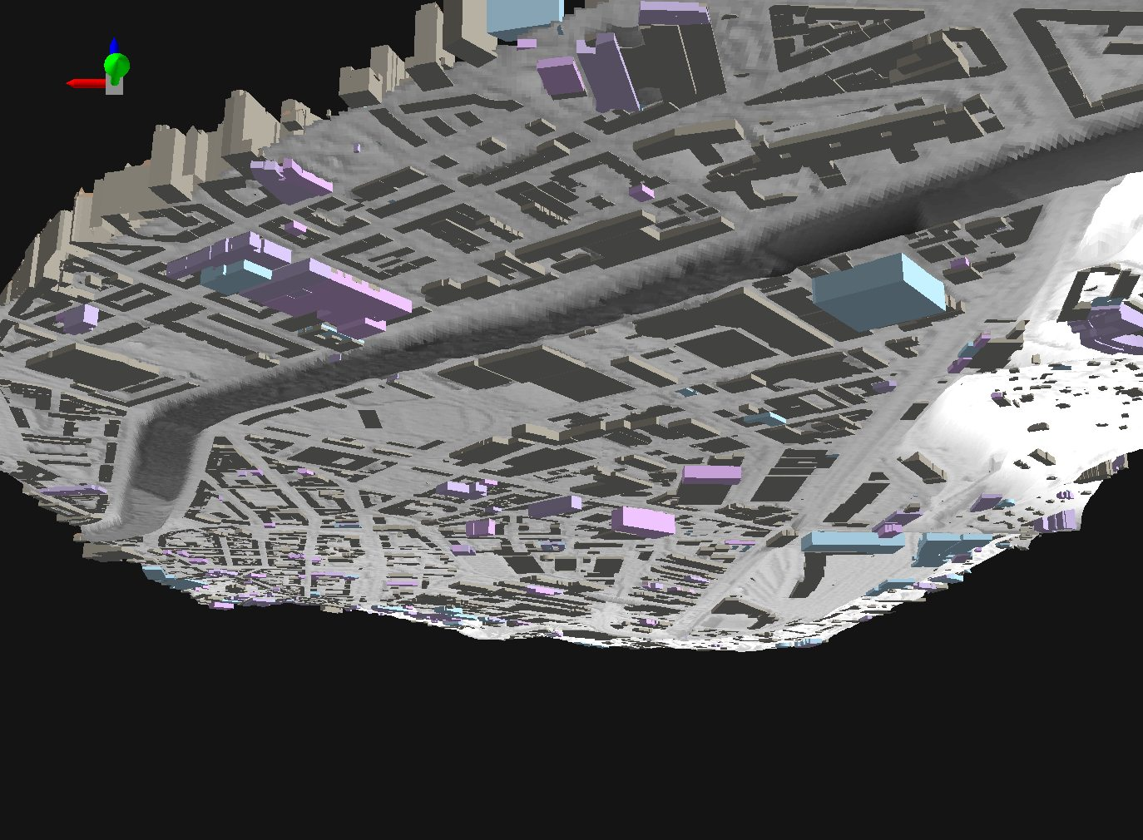
BIM / CIM and Geology
Comparison: underground construction data ←→ underground geological / geotechnical data
3D Buildings
(underground)

Slide 19
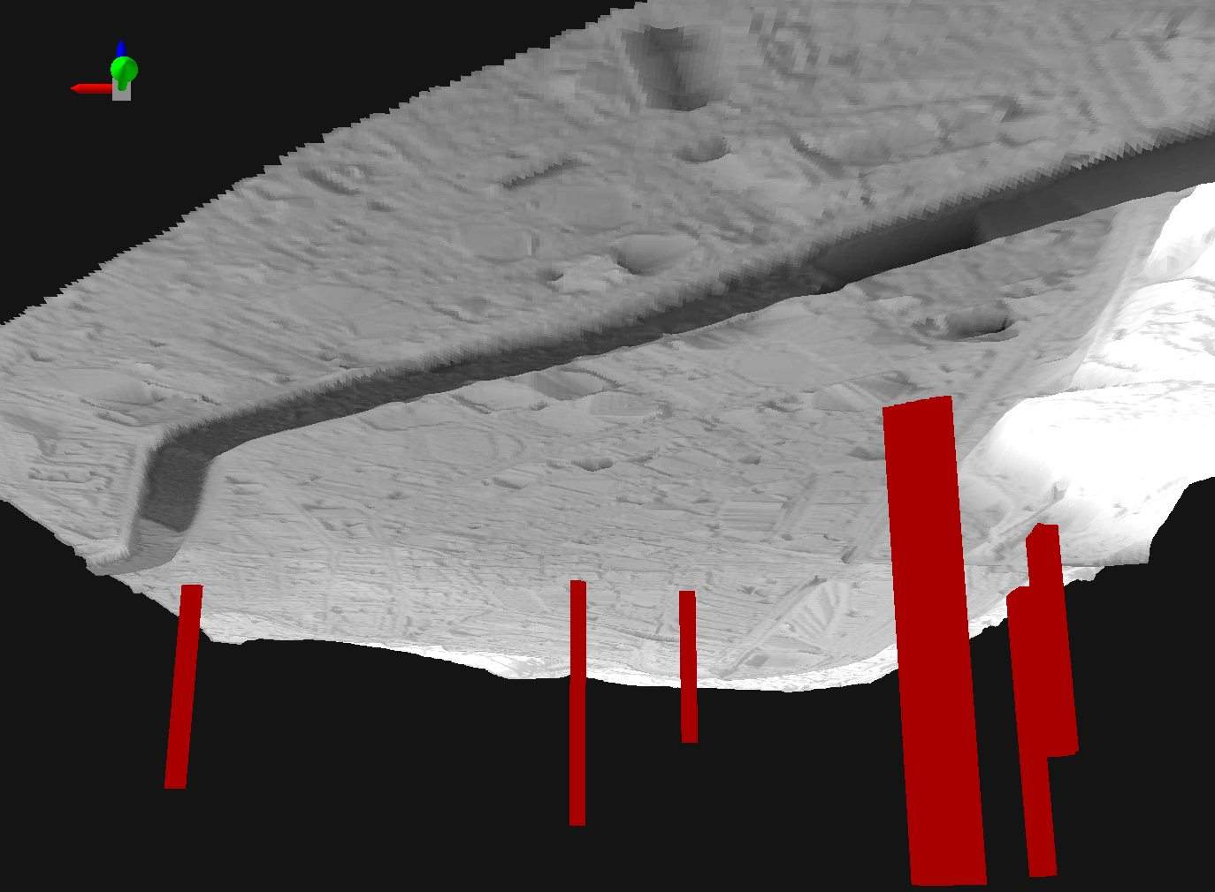
BIM / CIM and Geology
Comparison: underground construction data ←→ underground geological / geotechnical data
Geothermal probes

Slide 20
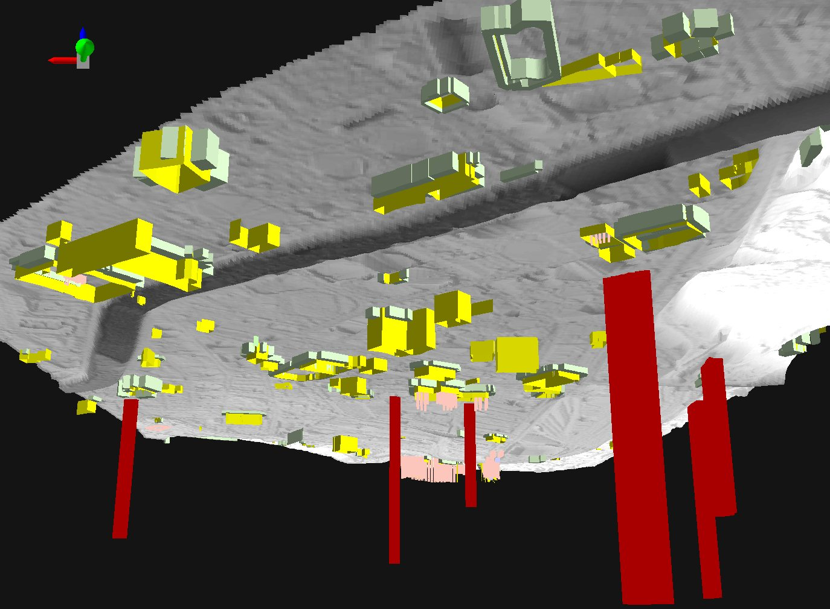
BIM / CIM and Geology
Comparison: underground construction data ←→ underground geological / geotechnical data
Sheet piles, piles, anchoring zones etc.

Slide 21
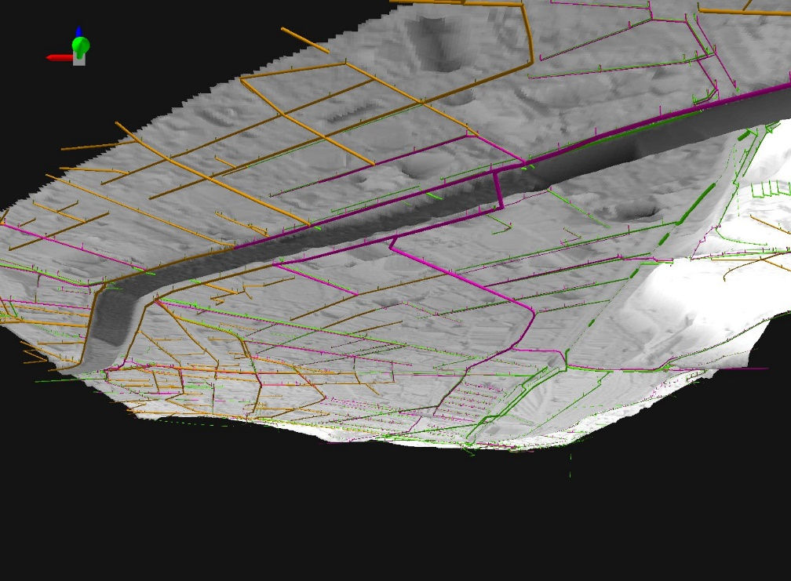
BIM / CIM and Geology
Comparison: underground construction data ←→ underground geological / geotechnical data
Register of sewage pipes

Slide 22
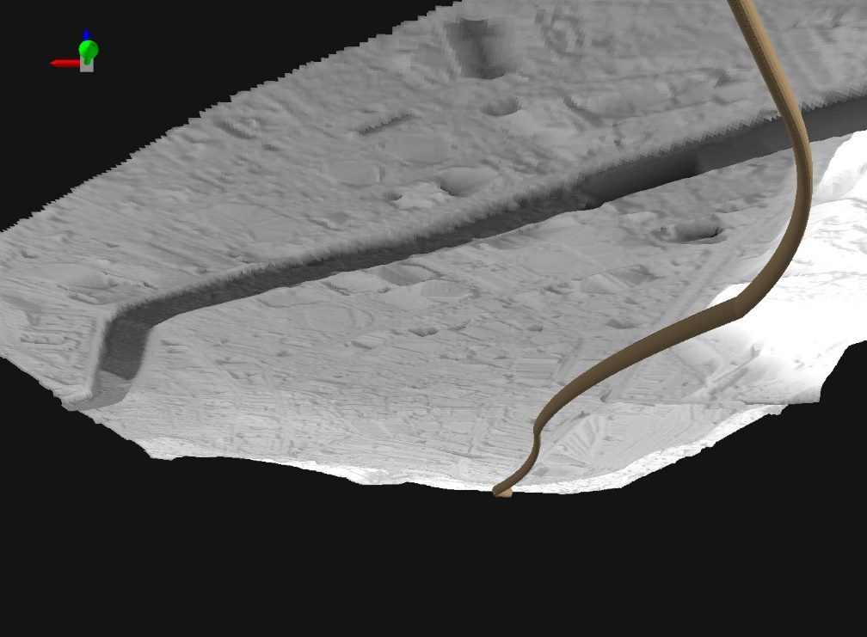
BIM / CIM and Geology
Comparison: underground construction data ←→ underground geological / geotechnical data
Tunnel (virtual)

Slide 23
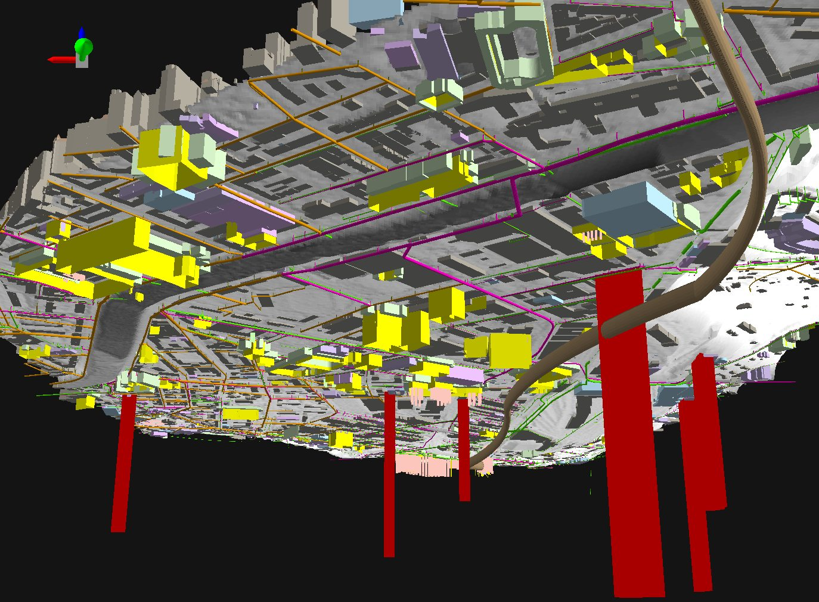
BIM / CIM and Geology
Comparison: underground construction data ←→ underground geological / geotechnical data
Overview of underground construction data

Slide 24
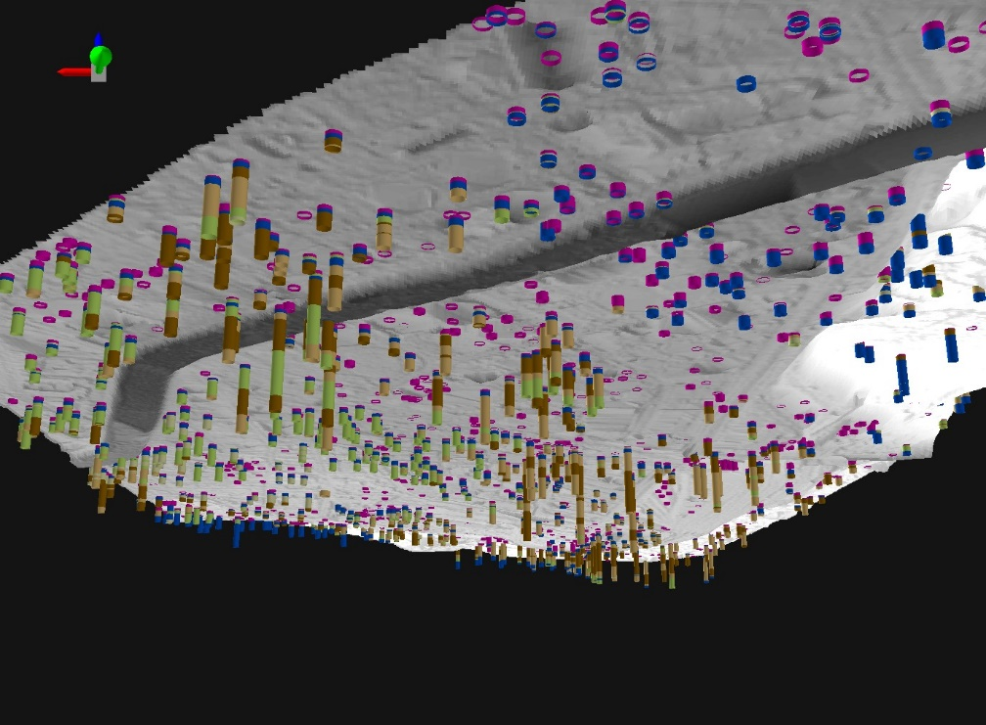
BIM / CIM and Geology
Comparison: underground construction data ←→ underground geological / geotechnical data
Boreholes

Slide 25
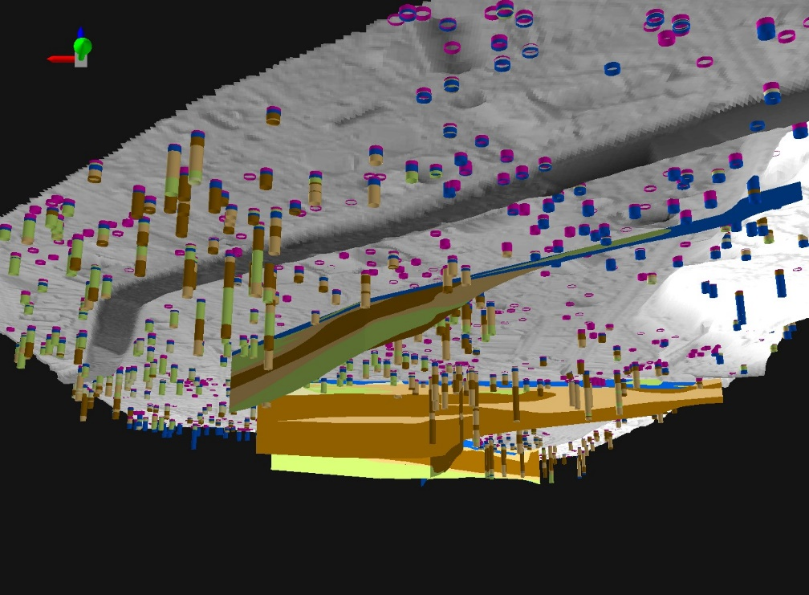
BIM / CIM and Geology
Comparison: underground construction data ←→ underground geological / geotechnical data
Boreholes + geological cross sections

Slide 26
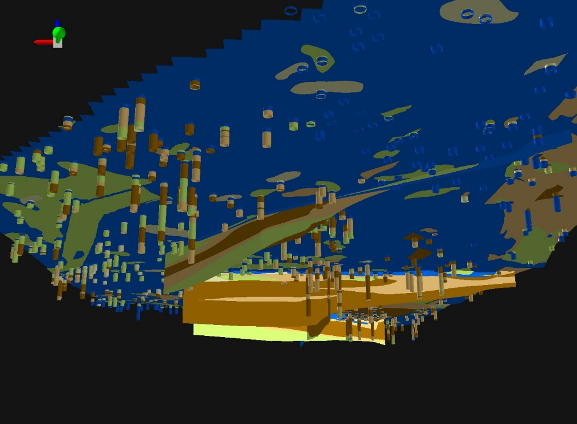
BIM / CIM and Geology
Comparison: underground construction data ←→ underground geological / geotechnical data
Boreholes + geological cross sections + geological map

Slide 27
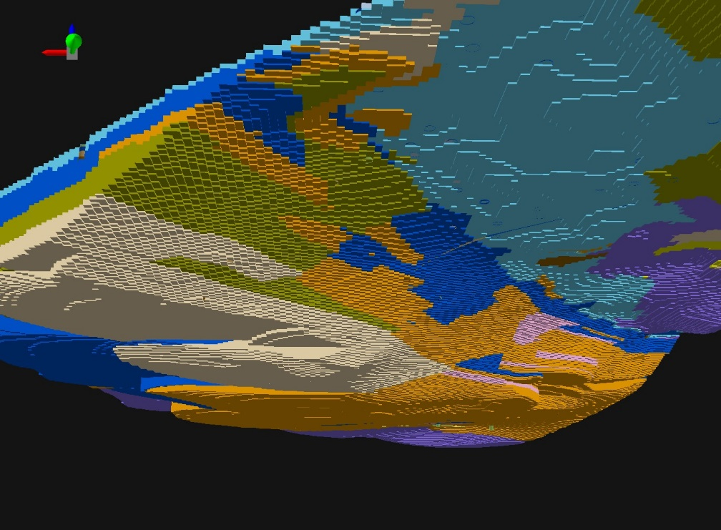
BIM / CIM and Geology
Comparison: underground construction data ←→ underground geological / geotechnical data
Geological 3D model (Voxel model)

Slide 28
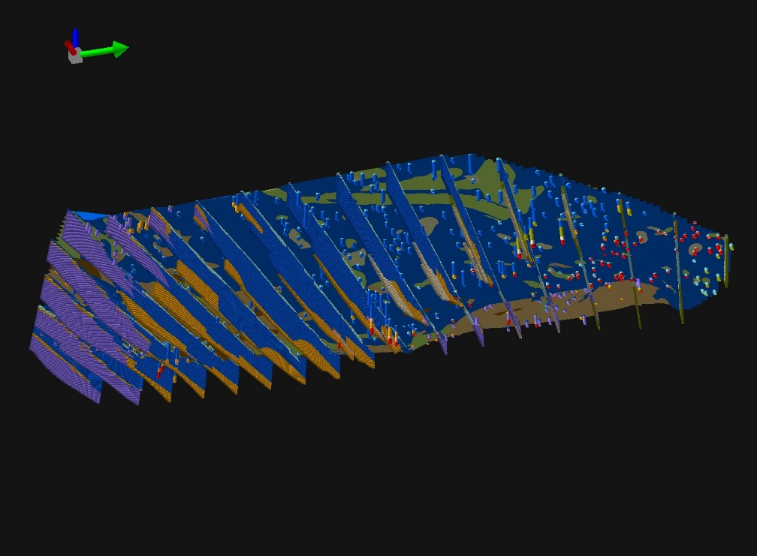
BIM / CIM and Geology
Comparison: underground construction data ←→ underground geological / geotechnical data
Cross sections of geological voxel model

Slide 29
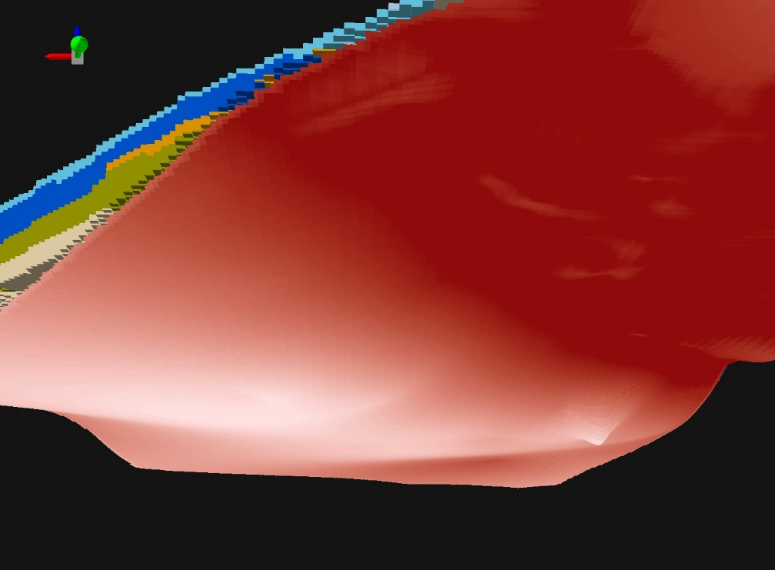
BIM / CIM and Geology
Comparison: underground construction data ←→ underground geological / geotechnical data
Rockhead surface

Slide 30
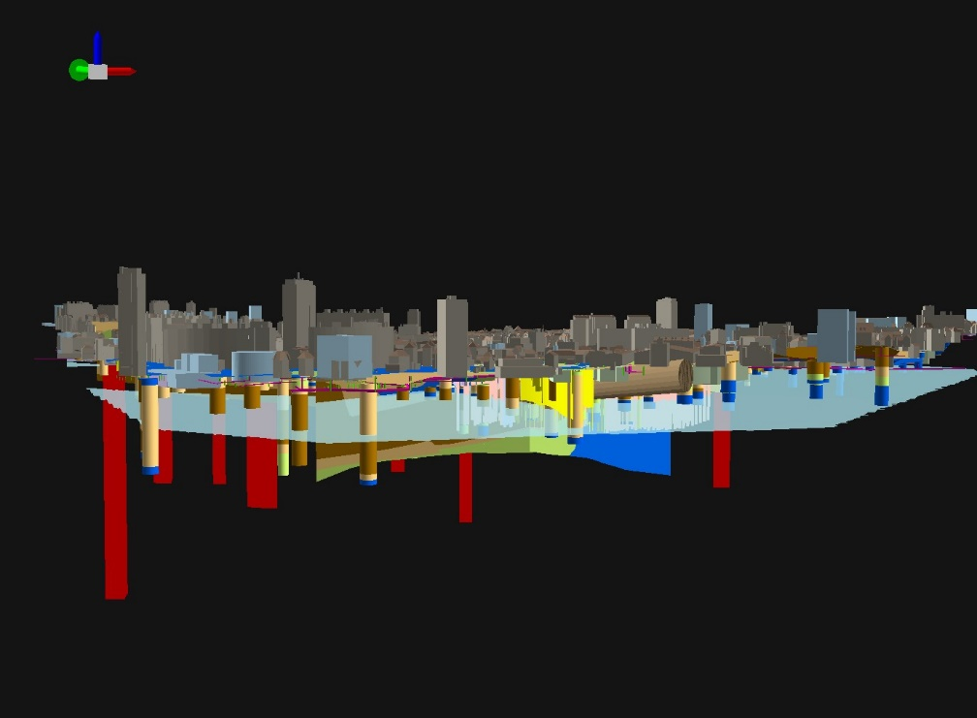
BIM / CIM and Geology
Comparison: underground construction data ←→ underground geological / geotechnical data
Hydrogeological data → groundwater table

Slide 31
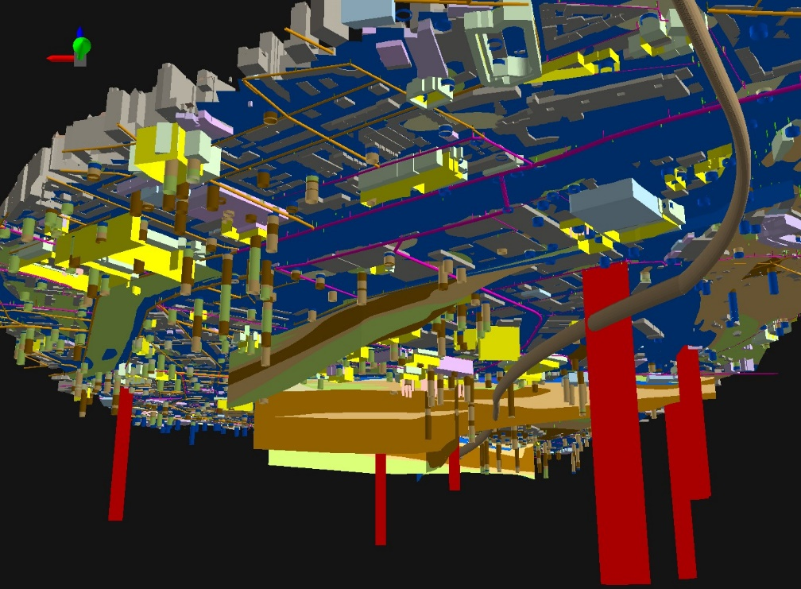
BIM / CIM and Geology
Comparison: underground construction data ←→ underground geological / geotechnical data
Overview of all data (without geological 3D model and groundwater table)

Slide 32
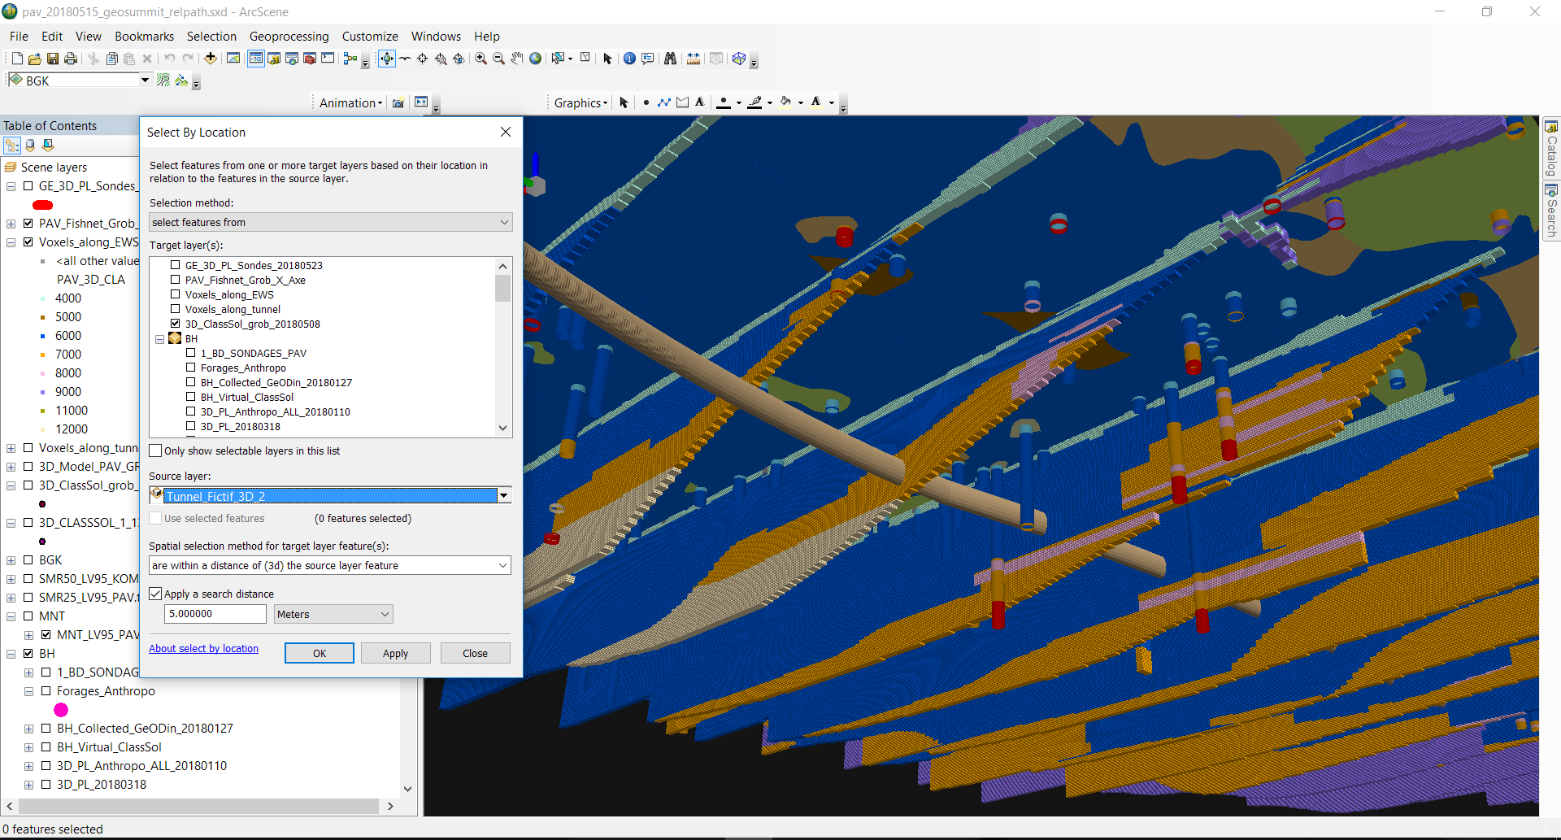
BIM / CIM and Geology
Interaction of construction data and geological data with the help of spatial queries / analyses, e.g. tunnel project planning

Slide 33
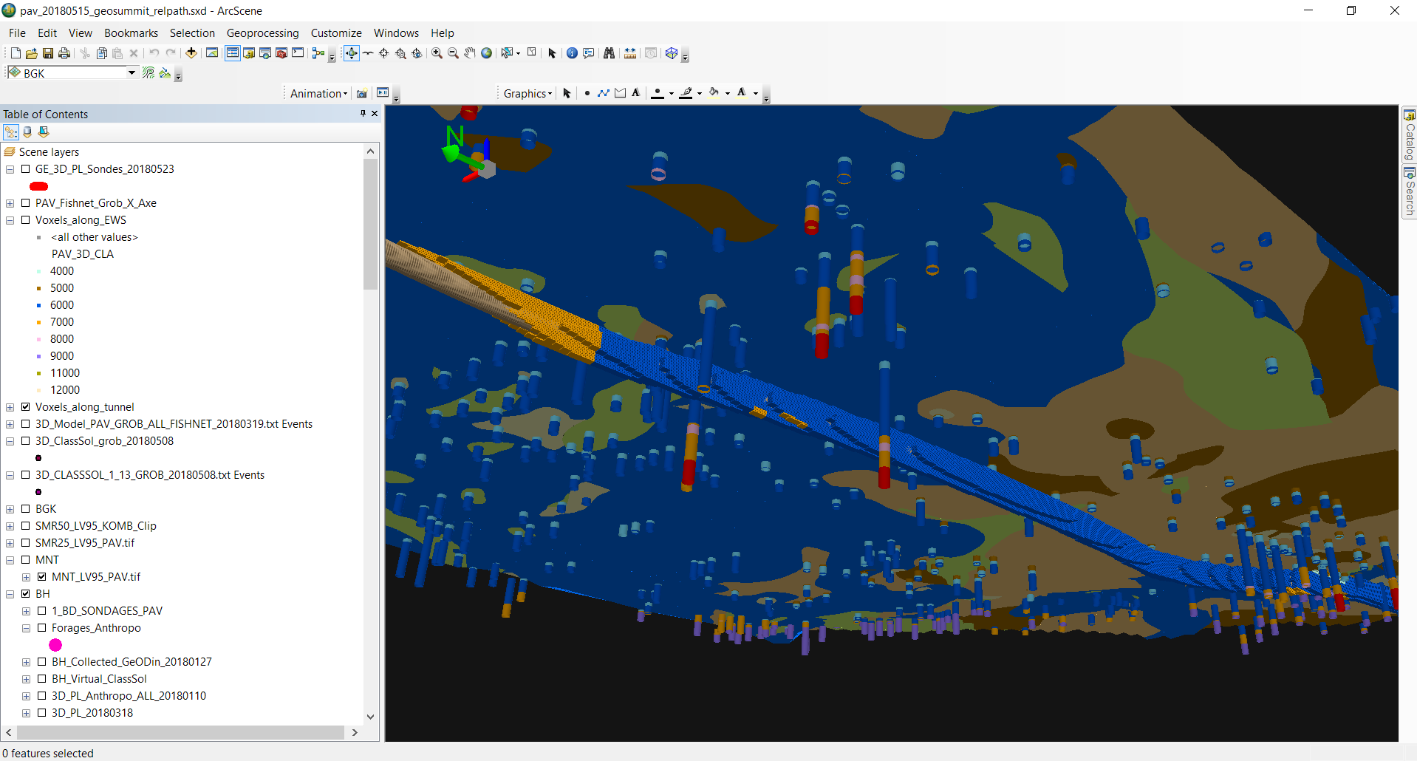
BIM / CIM and Geology
Interaction of construction data and geological data with the help of spatial queries / analyses, e.g. tunnel project planning

Slide 34
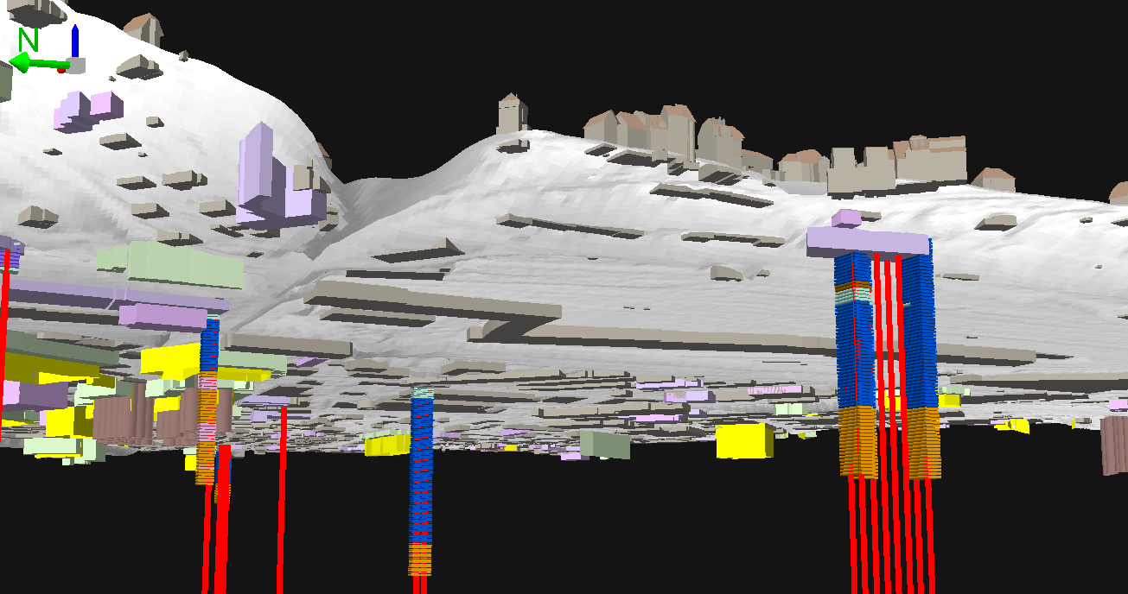
BIM / CIM and Geology
Interaction of construction data and geological data with the help of spatial queries / analyses, e.g. geothermal probes planning

Slide 35
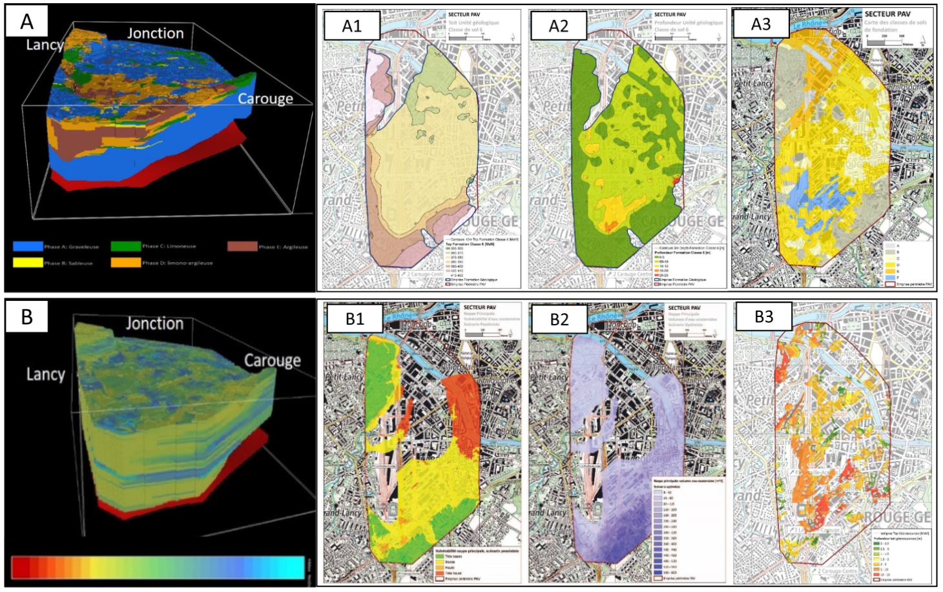
Post-Products from 3D models

Slide 36
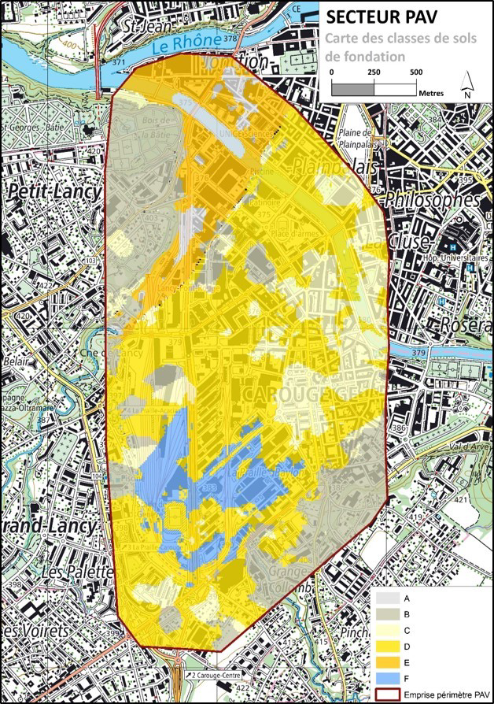
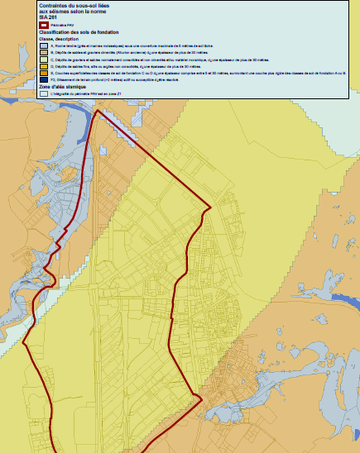
Ground Foundation Classes Map
Comparison with existing ground foundation class map in Geneva

Slide 37
Thank you for your attention
stefan.volken@swisstopo.ch

